Slide 1
Entity relationship design issues
By
Rimjhim Singh,
Asst. Professor,
CSE Department,
ASE, Coimbatore.

Slide 2
ER modelling
Notion of entity-sets and relationship-sets in not defined precisely.
Several approaches can be adopted for representation of real-world objects and their relationships.
Choice of ER designs depends upon the targeted enterprise.
Leads to few ER design issues to be considered.

Slide 3
ER decision issues
Basic design issues:
Use of Entity Sets versus attributes.
Use of Entity Sets versus Relationship Sets.
Binary versus n-ary Relationship Sets.
Placement of Relationship Attributes

Slide 4
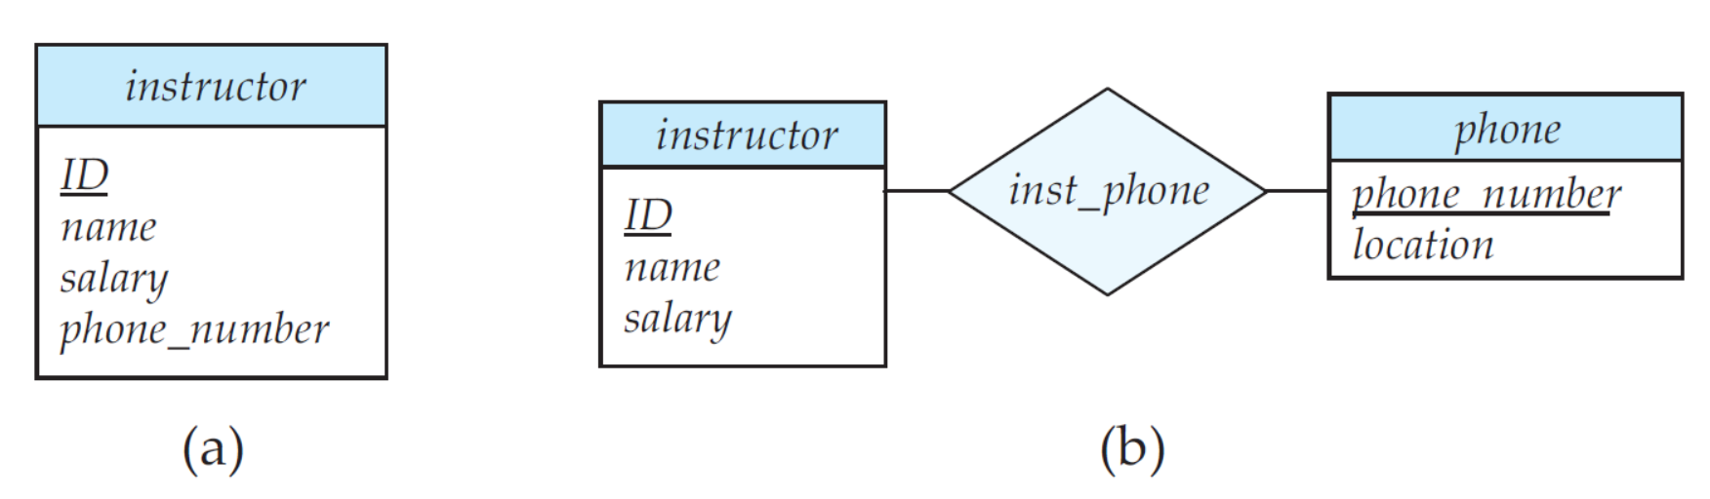
Use of entity sets versus Attributes
Fig (a) : Phone number can be a single-valued attribute.
Fig (b) : Phone number can be a multi-valued attribute.
Ex: Phone_number1 Office
Phone_number2 Home

Slide 5
Use of entity sets versus Attributes
Guideline: The choice mainly depends upon the depend on the structure of the real-world enterprise being modeled, and on the semantics associated with the attribute in question.

Slide 6
Use of entity sets Relationship sets
Guideline: Possible guideline is to designate a relationship set to describe an action that occurs between entities.
Scenario: Represent purchase of items by a customer.
Two possible correct approaches:
Approach 1: Simply use SALES relationship to model the situation.
C_NAME
I_ID
I_NAME
C_ID
ITEMS
SALES
CUSTOMERS
Approach-1 (Compact form)

Slide 7
Use of entity sets Relationship sets
Approach 2: We can use a third entity set INVOICE to model the situation in the following way.
C_NAME
I_ID
I_NAME
C_ID
ITEMS
CUSTOMERS
Belongs to
Contains
INVOICE
Scenario 2: Consider SALES relationship set maintains DATE and SALES_PERSON_ID (SP_ID).
Approach-1 is inefficient.
Data duplication and memory wastage

Slide 8
Use of entity sets Relationship sets
SP_ID
DATE
C_NAME
I_ID
I_NAME
C_ID
ITEMS
SALES
CUSTOMERS
Approach-1 (Compact form)
Approach-1 is inefficient.
Data duplication and memory wastage

Slide 9
Use of entity sets Relationship sets
Approach 2: INVOICE entity-set can maintain DATE and SP_ID only once for each invoice.
Data duplication can be avoided.
C_NAME
I_ID
I_NAME
C_ID
ITEMS
CUSTOMERS
Belongs to
Contains
INVOICE
IN_ID
SP_ID
DATE

Slide 10
Binary vs N-ary RELATIONSHIP SETS
Guideline: It is always possible to replace a non-binary relationship set by a number of distinct binary relationship sets.
FATHER
CHILD
PARENT
MOTHER
Approach 1: Ternary Relationship
Explicitly explains the relationship clearly.
Problem: Partial information will not be allowed.

Slide 11
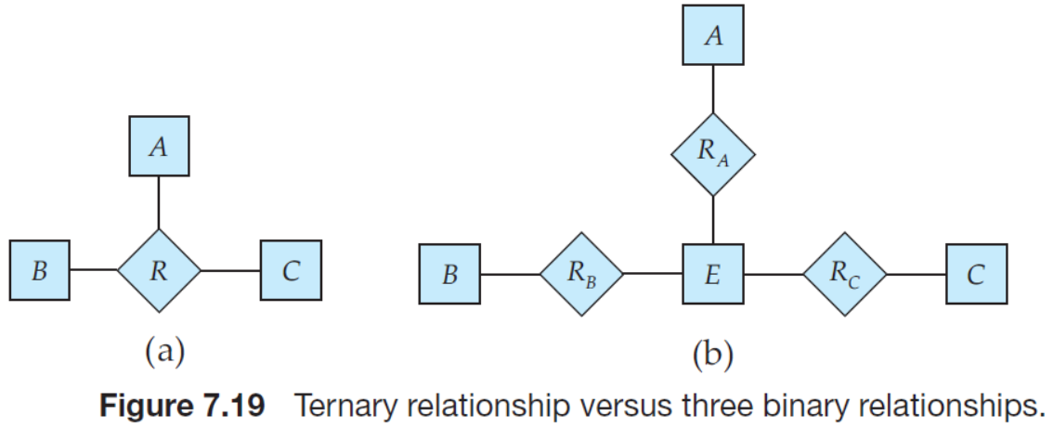
Binary vs N-ary RELATIONSHIP SETS
Conversion to Binary relationships:
Consider the ternary relationship set R, relating entity sets A, B, & C.
Replace relationship set R by an entity set E, and create three binary relationship sets
•R_{A}, relating E and A.
• R_{B}, relating E and B.
• R_{C}, relating E and C.

Slide 12
Binary vs N-ary RELATIONSHIP SETS
Conversion to Binary relationships:
Attributes of R are assigned to entity set E.
A special identifying attribute is created for E (say ID)
For each relationship (ai , bi , ci ) in R, create a new entity ‘ei’ in the entity set E.
Then, in each of the three new relationship sets, insert following relationships
• (ei , ai) in R_{A}.
• (ei , bi) in R_{B}.
• (ei , ci) in R_{A}.

Slide 13
Binary vs N-ary RELATIONSHIP SETS
CHILD
HAS
F_PAR
M_PAR
RELATIVE
FATHER
MOTHER
Approach 2: Conversion to Binary relationships
Partial information is allowed.
One can enter the Father’s information even though Mother’s information is unknown.

Slide 14
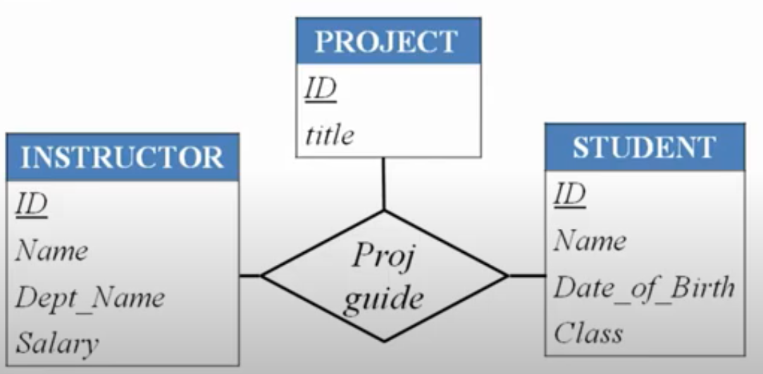
Binary vs N-ary RELATIONSHIP SETS
Problems:
Increased complexity of the design and storage requirements.
•Translating constraints may be difficult or impossible.
•Unwanted or invalid data may be present.
• Some n-ary relationships cannot be converted to binary relationships
Loss of information
Loss of information will be there.
Cannot tell exactly which student is allotted to an instructor for specific projects

Slide 15
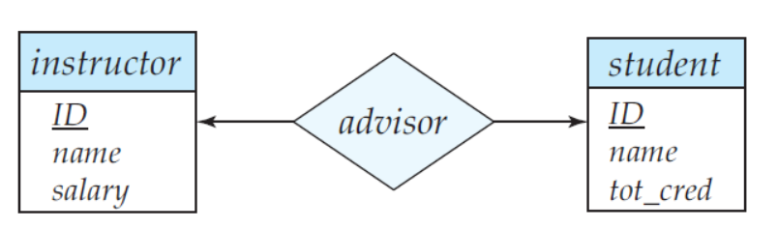
Placement of Attributes
Cardinality ratio of a relationship can affect the placement of relationship attributes.
One to one relationships
Relationship attribute can be associated with either one of the participating entities
I_ID | S_ID | DAT
I1 | S1 | 10-02
I2 | S3 | 18-02
I3 | S4 | 17-02
I7 | S22 | 1-04
I11 | S23 | 12-04
Date
Date can be placed with ‘instructor or ‘student’’

Slide 16
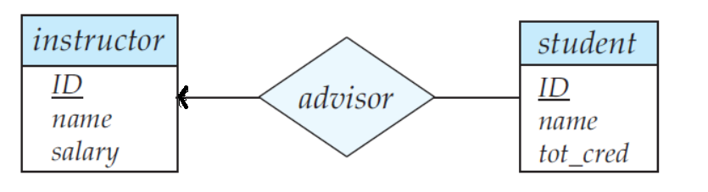
Placement of Attributes
Cardinality ratio of a relationship can affect the placement of relationship attributes.
One to many relationship or Many to one relationship
Relationship attribute can be repositioned to only the entity set on the many side of the relationship.
I_ID | S_ID | DAT
I1 | S1 | 10-02
I1 | S3 | 18-02
I1 | S4 | 17-02
I7 | S22 | 1-04
I11 | S23 | 12-04
Date
Date must be placed with ‘student’’

Slide 17
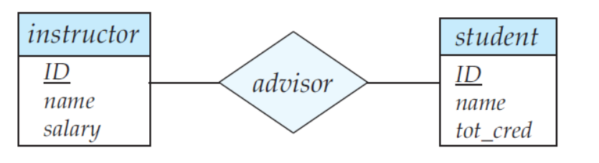
Placement of Attributes
Cardinality ratio of a relationship can affect the placement of relationship attributes.
Many to many relationships
Relationship attribute must be associated with relationship sets rather than with any of the participating entities
I_ID | S_ID | DAT
I1 | S1 | 10-02
I1 | S3 | 18-02
I2 | S1 | 17-02
I2 | S3 | 1-04
I11 | S23 | 12-04
Date must be placed with ‘advisor’
Date

Slide 18
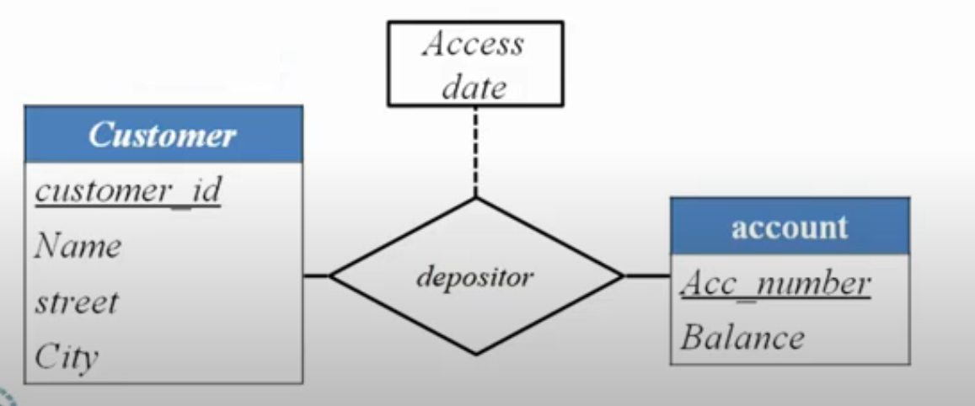
ACTIVITY-1
Place attribute ‘Access date’ of relationship set ‘depositor’:
1. Many to One Relationship.
2. One to One Relationship.
3. One to Many Relationship.
4. Many to Many Relationship

